Slide 1
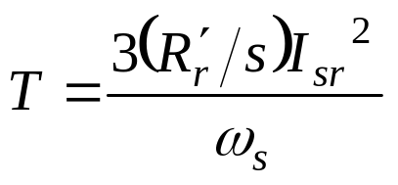
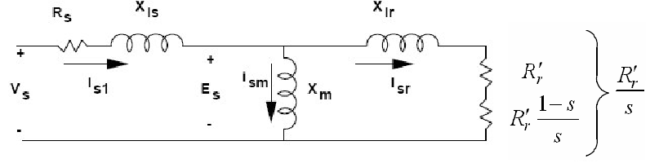
Induction Machines
OPERATING CHARACTERISTICS
We can study the motor performance using the equivalent circuit. To find the torque we only need to find the rotor current (reflected to stator):

Slide 2
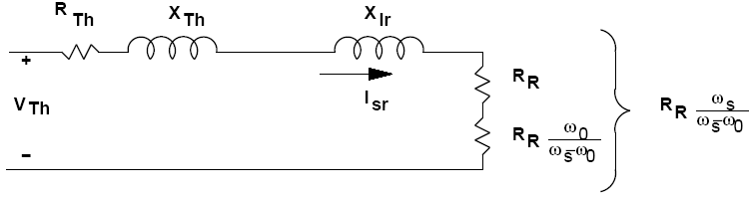
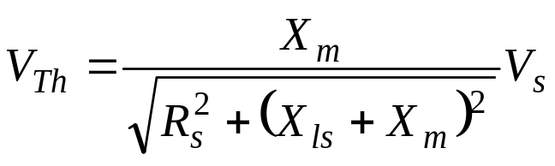
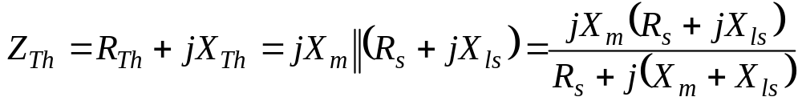
Induction Machines
OPERATING CHARACTERISTICS
We can study this point if we take the Thevenin equivalent circuit of the left part of the stator equivalent circuit. This will give us the circuit:

Slide 3
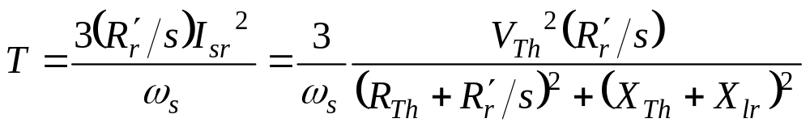
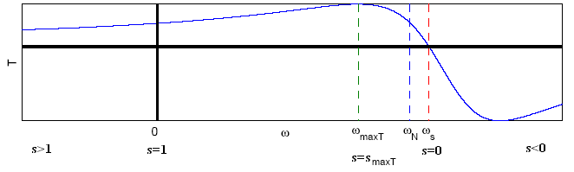
Induction Machines
OPERATING CHARACTERISTICS
Then we arrive at formula for the torque:
For a certain supply voltage and frequency, we can develop torque speed curves, by selecting speeds, solving the equivalent circuit and calculating Torque.

Slide 4
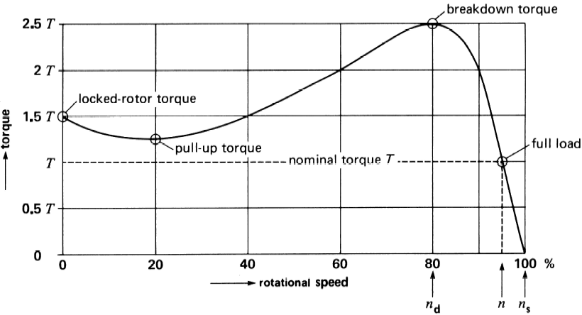
Induction Machines
Torque-speed Characteristics

Slide 5
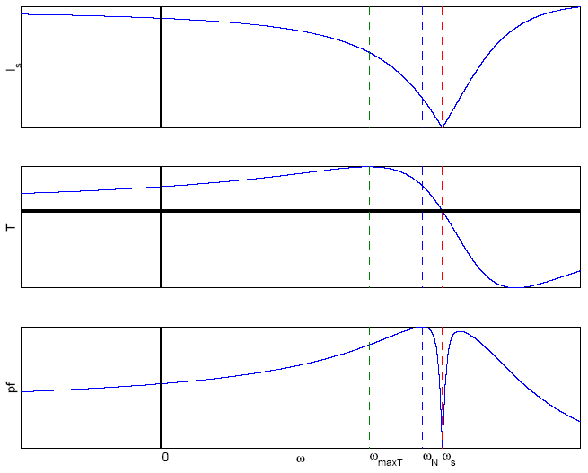
Induction Machines
OPERATING CHARACTERISTICS
We can also find current and power factor of an induction motor versus speed

Slide 6
Induction Machines
OPERATING CHARACTERISTICS
There are three areas of interest:
1. For speed 0≤ ω₀≤ω_{s}, the torque is of the same sign as the speed, and the machine operates as a motor. The machine is often designed to operate as a motor, and the operating point is near or exactly where the power factor is maximized. It is for this point that the motor characteristics are given on the nameplate, rated speed, current, power factor and torque.
2. For speed ω₀≤0, torque and speed have opposite signs, and the machine is in breaking mode. Notice that the current is very high, resulting in high winding losses.
3. for speed ω₀≥ω_{s}, the speed and torque are of opposite signs, the machine is in generating mode, and the current amplitude is reasonable.

Slide 7
Induction Machines
OPERATING CHARACTERISTICS
A point of interest is starting, ( slip s = 1) where the torque is not necessarily high, but the current often is. When selecting a motor for an application, we have to make sure that this starting torque is adequate to overcome the load torque, which may also include a static component. In addition, the starting current is often 3-6
times the rated current of the machine. If the developed torque
at starting is not adequately higher than the load starting torque, their difference, the accelerating torque will be small and it may take too long to reach the operating point. This means that the current will remain high for a long time, and fuses or circuit breakers may operate.

Slide 8
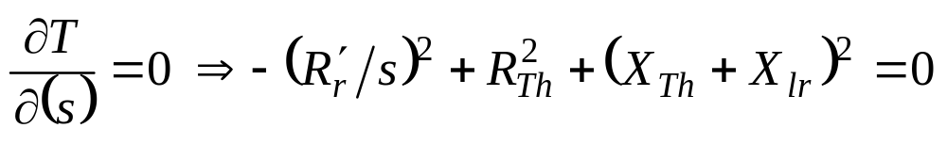
Induction Machines
OPERATING CHARACTERISTICS
Another point of interest is the maximum torque, T_{max}, corresponding to speed ω_{Tmax}. This point is interesting, since points to the right of it correspond in general to stable operating conditions, while point to its left correspond to unstable operating conditions. We can find it by analytically calculating torque as a function of slip, and equating the derivative to 0.

Slide 9
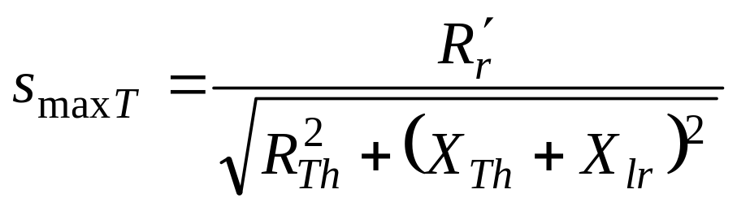
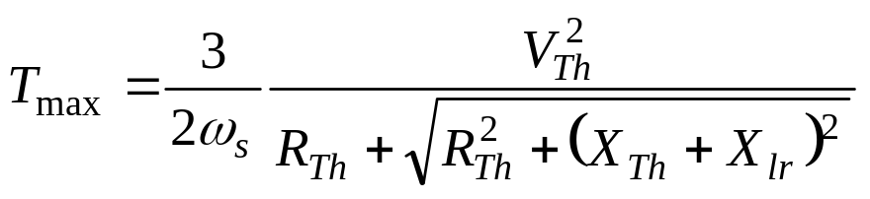
Induction Machines
OPERATING CHARACTERISTICS
We then find the slip at which the maximum torque will occur as:
Putting s_{maxT} into the torque equation gives the maximum torque, aka; the breakdown torque:

Slide 10
Induction Machines
The effect of Rotor Resistance
Note that the maximum torque is independent of the rotor resistance.
However the slip at which the maximum torque occurs, is proportional to the rotor resistance:
So if the rotor resistance is increased, the torque-speed characteristic is shifted to the left.

Slide 11
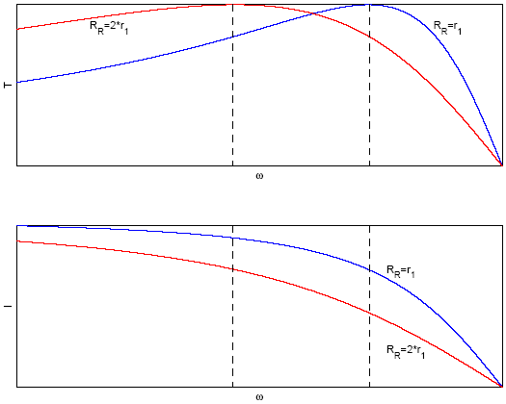
Induction Machines
The effect of Rotor Resistance

Slide 12
Induction Machines
The effect of Rotor Resistance
The starting torque is increased with increase in s_{maxT} and so with increase in the rotor resistance.
The maximum starting torque occurs when s_{maxT}=1.
If we have convenient ways to increase the rotor resistance, we can increase the starting torque, while decreasing the starting current. Increasing the rotor resistance can be easily accomplished in a wound rotor machine, and more complex in squirrel cage motor, by using double or deep rotor bars.

Slide 13
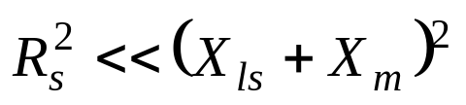
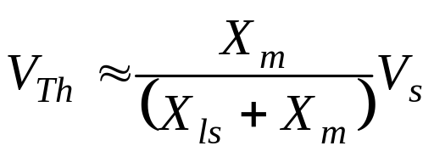
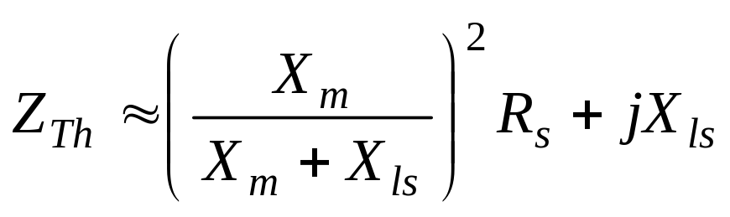
Induction Machines
OPERATING CHARACTERISTICS
In a well designed induction machine we often find that:
So, finding the Thevenin equivalent circuit parameters can be more simplified:

Slide 14

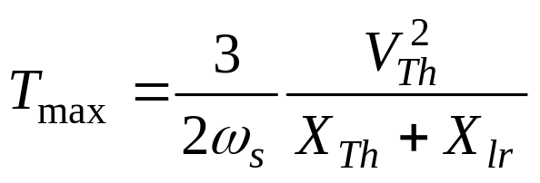
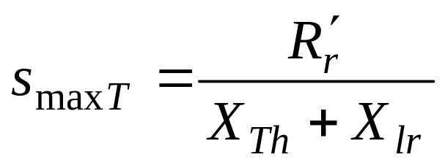
Induction Machines
OPERATING CHARACTERISTICS
In a real induction machine the stator resistance is often quite small. If we neglect the stator resistance:
Then:

Slide 15
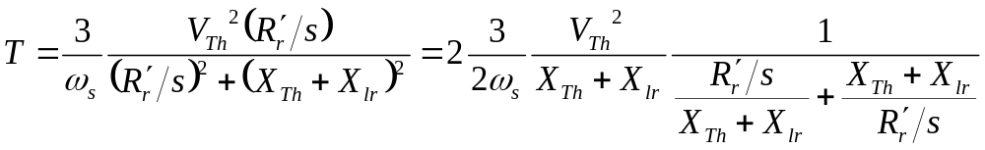
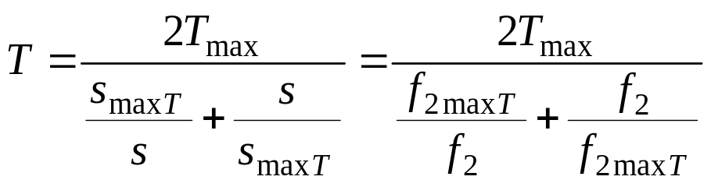
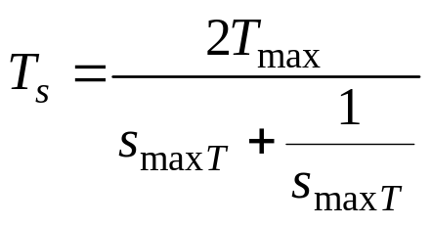
Induction Machines
OPERATING CHARACTERISTICS
The torque equation is then simplified to:
Then the following useful equation, namely Kloss formula, is obtained:
The starting torque can be found by putting s=1.

Slide 16
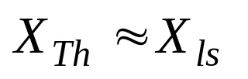
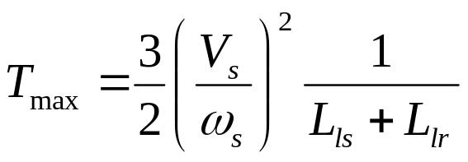
Induction Machines
OPERATING CHARACTERISTICS
Furthermore if the stator leakage reactance would be much smaller than the magnetizing inductance, i.e., X_{ls}<<X_{m} then:
Then we can develop simple formulae for T_{max}:
We notice that the maximum torque is a function of V_{s}/ω_{s}.

Slide 17
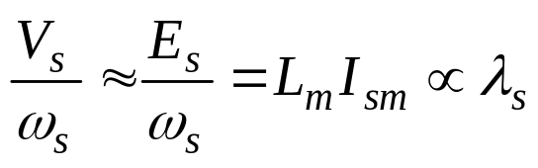
Induction Machines
OPERATING CHARACTERISTICS
Neglecting the drop on the stator resistor and leakage inductance, we find that V_{s}/ω_{s} is proportional to the airgap flux.
This means that we can change the frequency of the stator voltage, but as long as the voltage amplitude changes so that the flux stays the same, the maximum torque will also stay the same.

Slide 18
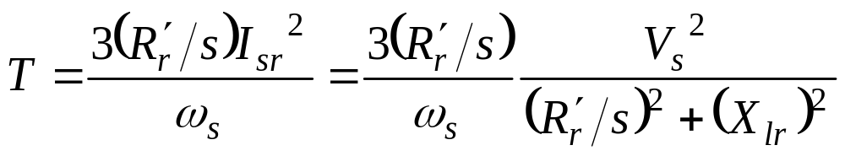
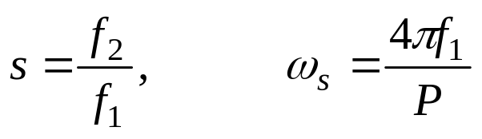
Induction Machines
OPERATING CHARACTERISTICS
Neglecting the drop on the stator resistor and leakage inductance (This is usually true unless at very low frequencies),
On the other hand:

Slide 19
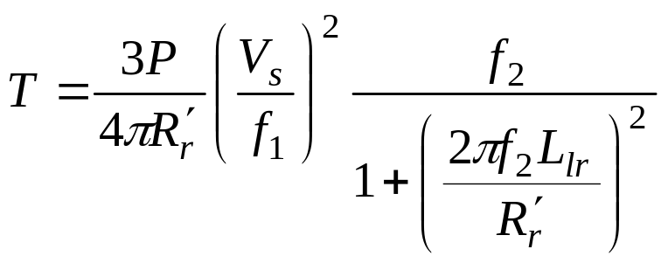
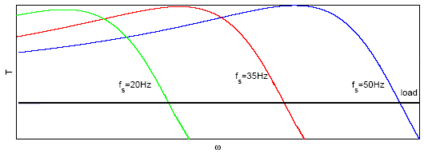
Induction Machines
OPERATING CHARACTERISTICS
If the stator frequency would be changed so that V_{s}/f₁ is kept constant, then for a given load the rotor frequency remains constant. As ω_{m}= ω_{s}- ω₂ then the operating point difference with respect to the synchronous speed is the same. It means that the shape of torque-speed curve remains unchanged.

Slide 20
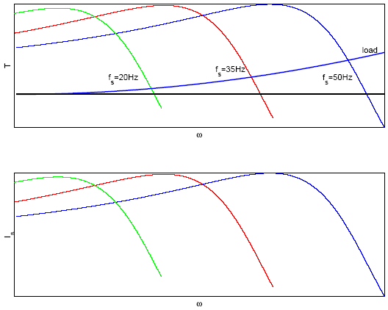
Induction Machines
OPERATING CHARACTERISTICS
This is called Constant Volts per Hertz Operation and it is a first approach to controlling the speed of the motor through its supply.

Slide 21
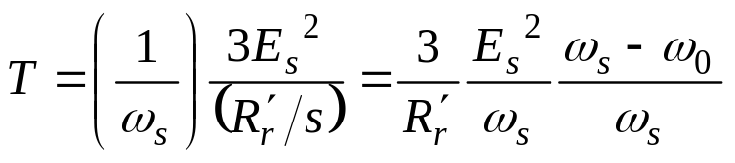
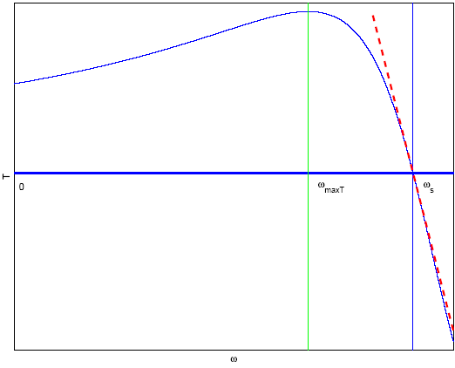
Induction Machines
OPERATION NEAR SYNCHRONOUS SPEED
Near synchronous speed the effect of the rotor leakage inductance can be neglected, as discussed earlier. This assumption gives us the approximate torque-speed equation discussed earlier.
It is important to notice that the torque calculated from the approximate equation is grossly incorrect away from synchronous speed.

